Slide 1
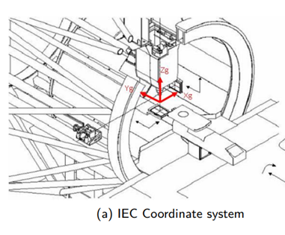
World Coordination (IEC)
Right-hand

Slide 2
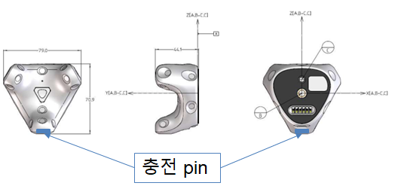
ViveTracker Coordination
Right-hand
Z
Z
Y
X

Slide 3
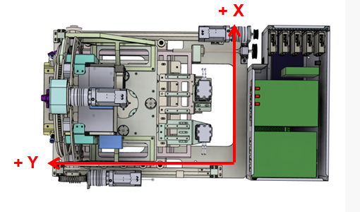
Multislit Coordination
Right-hand

Slide 4
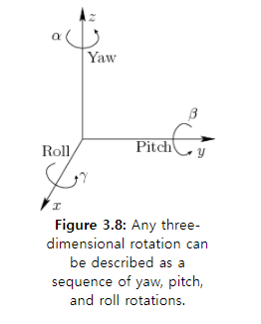
Coordination definition
Yaw, pitch, roll
Right-hand
Rotation: counter-clockwise
Ref: 3D translation (uiuc.edu)

Slide 5
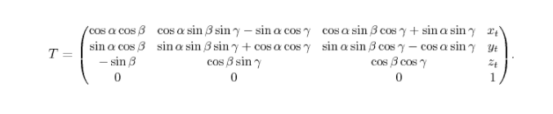

Coordination definition (Yaw, pitch, roll to transformation)
Right-hand
Column Major
Ref: Yaw, pitch, and roll rotations (uiuc.edu)
Roll first, then the pitch, and finally the yaw

Slide 6
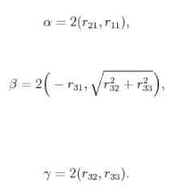

Coordination
n definition (transformation to yaw pitch roll)
Right-hand
Column Major
Ref: Yaw, pitch, and roll rotations (uiuc.edu)
Roll first, then the pitch, and finally the yaw

